Slide 1
Advanced GUI
Università di Modena e Reggio Emilia
Prof. Nicola Bicocchi (nicola.bicocchi@unimore.it)

Slide 2

Issue
Whenever we see a list or grid of items in an app, we can state with certainty that it is using an Adapter and Adapter View. In general, when we create or read a list or grid of data, we think we can use a loop to scroll through the data and then set the data to create the list or grid, but what if the data is a set of 1 million products? Using a loop will not only consume a lot of time, making the app slow, but may also end up consuming all of the runtime memory. All these problems are solved using Adapter and Adapter View.
Data Source
?
Bob
getData()
Alice
{“Bob”,”Alice”,”Elen”}
Elen
Show Data
Show Data

Slide 3
Adapters & AdapterViews
Android Adapters are “a bridge between an AdapterView and the underlying data for that view”.
AdapterView: is a group of widgets (aka view) components in Android that include the ListView, Spinner, and GridView. In general, it is the widgets that provide the ability to select in the UI. AdapterView is responsible for how data should be displayed. Adapter Views controls and display View objects repeatedly. It contains a set of Views that display data from data source
Adapter: is responsible to managing the data, It reads data from various data sources, coverts it into View objects and provide it to the linked Adapter view to create UI components.
Data Source
Adapter
Bob
Alice
Elen

Slide 4
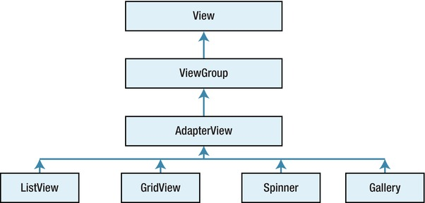
AdapterViews

Slide 5

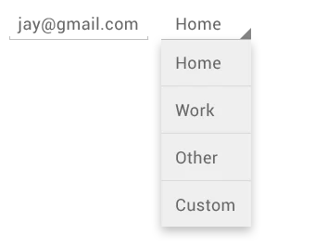

AdapterViews: Type
ListView: It displays a vertically-scrollable collection of views, where each view is positioned immediately below the previous view in the list.
Spinners: provide a quick way to select one value from a set of values. Touching the spinner displays a dropdown menu with all other available values, from which the user can select a new one.
GridView: is a ViewGroup that displays items in a two-dimensional, scrollable grid.

Slide 6
Adapter: Type
An Adapter acts as a bridge between the data source and the user interface, its task is to
retrieve data, regardless of their origin ( Array, List), convert them to View and provide them to the connected AdapterView to create a View . We can create an Adapter by extending the class BaseAdapter (superclass) . Android provides different types of adapters:
ArrayAdapter: takes data from the array creates a view out of it that we can use
BaseAdapter: custom adapter definable and customized in terms of: how data should be tracked, how data should be processed, how views should be generated and so on.
CursorAdapter : makes access to the association of the values of
data.
SimpleCursorAdapter: takes the data from a cursor and creates a view out of it that we can use. Cursor is Android object that represents data taken from database
Custom ArrayAdapter : displays the custom list of an array.
CustomSimpleAdapter : displays a custom list and gives you access
then pass them to AdapterView, is used to manage data

Slide 7
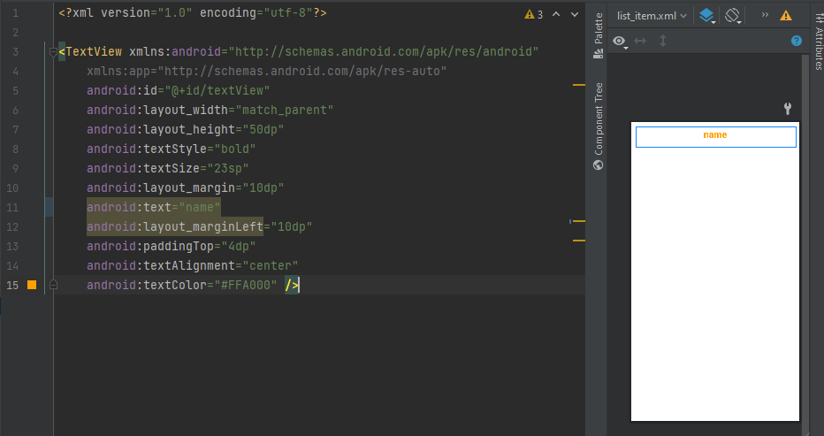
Adapter vs AdapterView
Despite the likelihood between the names these two objects perform different tasks:
The Adapter is only responsible for retrieving data from a data source and converting it to View and then passing it to AdapterView, it is used to manage data. Instead, the AdapterView is responsible for displaying the data. The following example will show all name inside this array into TextViews on the screen, but first in necessary define a layout for the item inside array that we want to display:

Slide 8
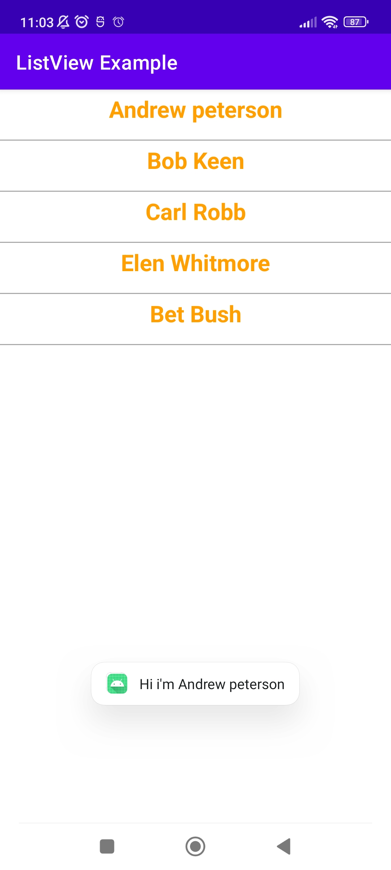
Example
public class MainActivity extends AppCompatActivity { ListView listView; TextView textView; String[] employee = { "Andrew peterson", "Bob Keen", "Carl Robb", "Elen Whitmore", "Bet Bush" }; @Override protected void onCreate(Bundle savedInstanceState) { super.onCreate(savedInstanceState); setContentView(R.layout.activity_main); listView = findViewById(R.id.listView); textView = findViewById(R.id.textView); final ArrayAdapter adapter = new ArrayAdapter(this, R.layout.list_item, R.id.textView, employee); listView.setAdapter(adapter); listView.setOnItemClickListener((adapterView, view, position, l) -> { String value = "Hi i'm " + adapter.getItem(position); /* Display the Toast */ Toast.makeText(getApplicationContext(), value, Toast.LENGTH_SHORT).show(); }); } }

Slide 9
RecyclerView

Slide 10
Issue
The Adapters and AdapterView seen allow the dynamic creation of the data layout to be displayed in our application. However, there is a problem with viewing a large data source.
Each element found from the data source is retrieved and connected to a View created to be inserted in the XML layout with the LayoutInflater object, the operation of inflate (inflation) is very expensive in terms of performance.

Slide 11
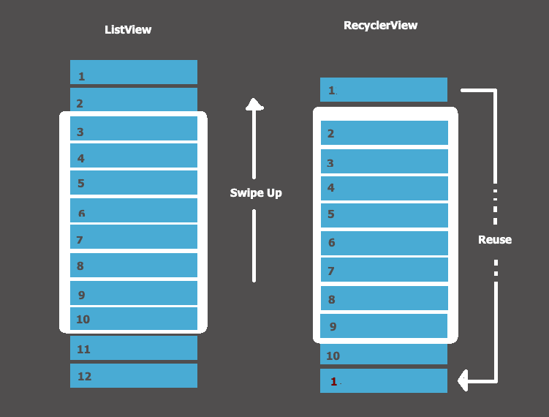
Solution
RecyclerView works like listview, but its main feature is recycling View:once a View leaves the areavisible screen, is placed in a queue, and will be re-elevated, filled with new data to be displayed. You can also display 100 records using a dozen View, thus saving CPU usage.

Slide 12
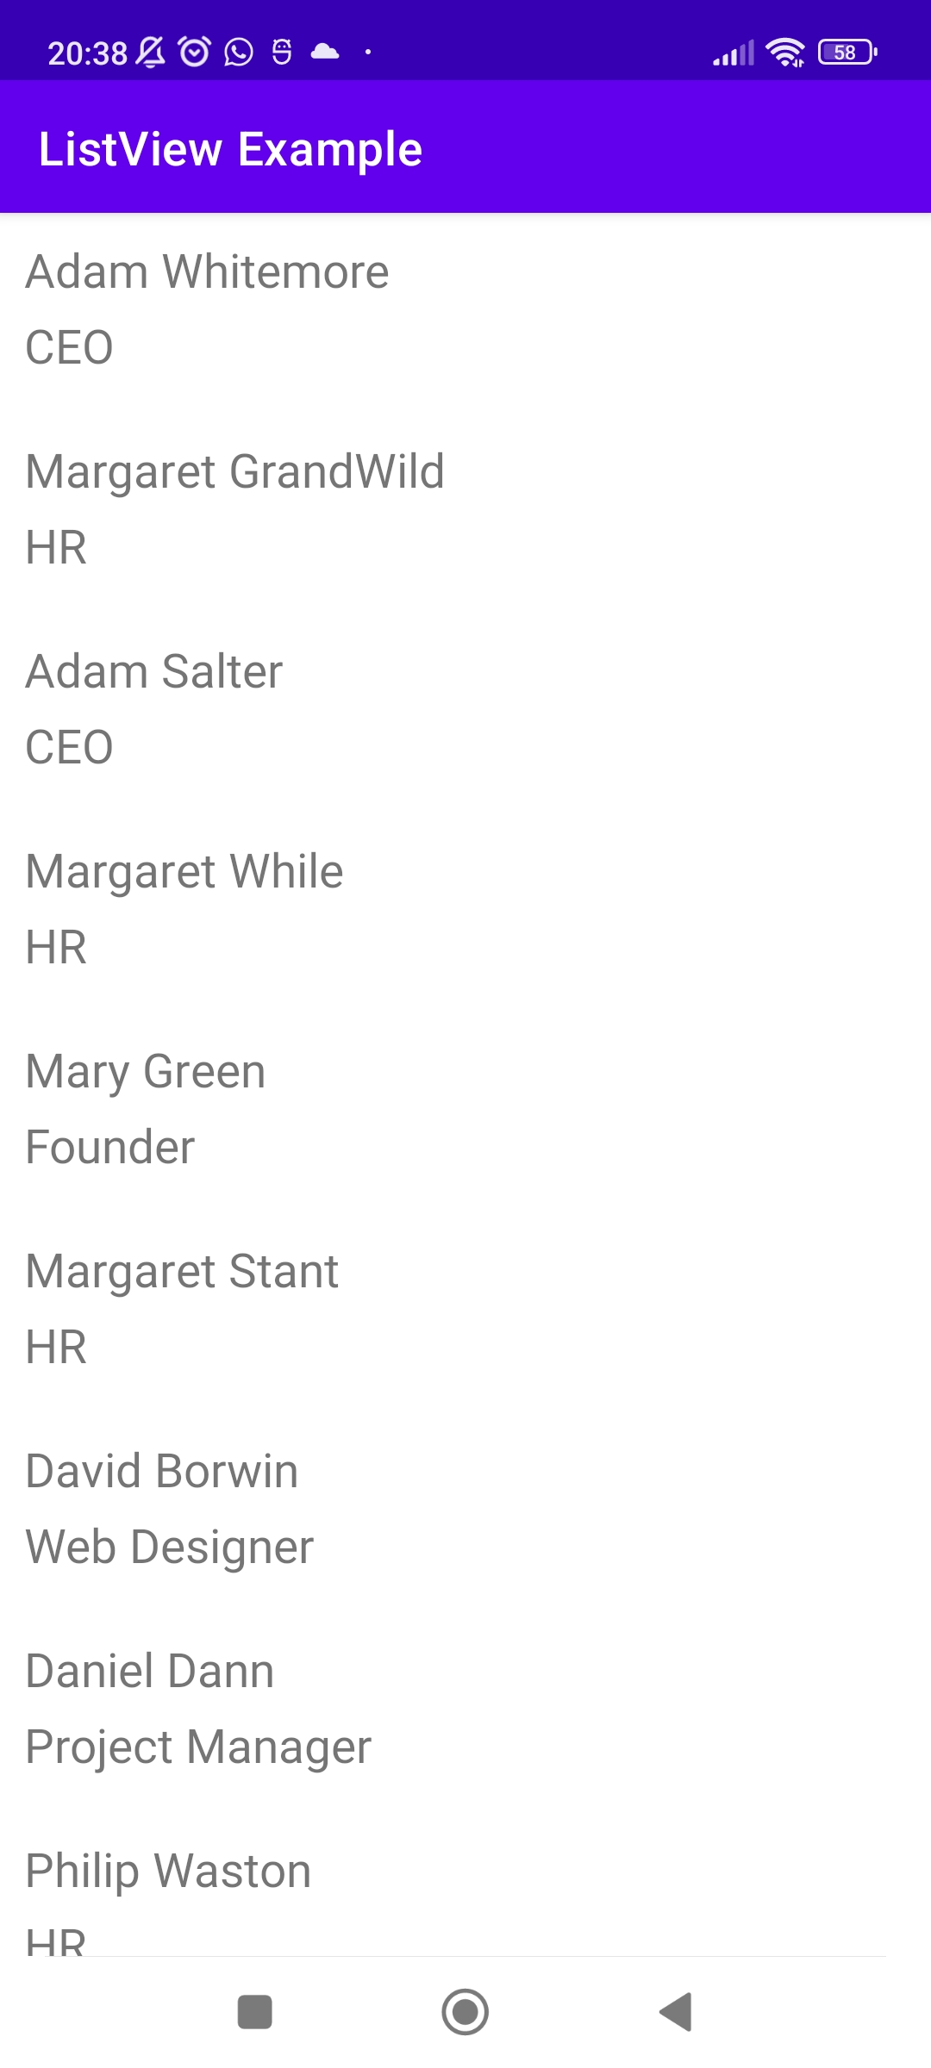
Architecture
Using the RecyclerView requires configuring / implementing the following components:
RecyclerView: manages everything. It’s mostly pre-written by Android. You provide the components and configuration.
Adapter: you will spend most of your time coding this class. It connects to the data source. When instructed by the RecyclerView, it creates or updates the individual items in the list.
Return information about number of items with getItemCount()
Data Source
RecyclerView
Adapter
id | Name
Id1 | Andrew Peterson
Id2 | Bob Keen
id2 | Carl Robb
View Holder
Create new view instances onCreateViewHolder
Populate view items with data onBindViewHolder()

Slide 13
Architecture
Return information about number of items with getItemCount()
ViewHolder: a simple class that assigns / updates the data in the view items. When a view is re-used, the previous data is overwritten.
Data source: anything you like – from a simple array up to a full-blown data source. Your Adapter interacts with it.
LayoutManager: is responsible for placing all the individual view items on the screen and making sure they get the screen-space they need
Data Source
RecyclerView
Adapter
id | Name
Id1 | Andrew Peterson
Id2 | Bob Keen
id2 | Carl Robb
View Holder
Create new view instances onCreateViewHolder
Populate view items with data onBindViewHolder()

Slide 14
Implementation:RecycleViewAdapter
The first step for the concrete and correct implementation is the override of the methods of the inner-class ViewHolder:
onCreateViewHolder(): Creates a ViewHolder object only when you no longer have it than RecyclerView. For example, if RecyclerView can display 5 items at a time, 5-6 ViewHolder will be created and reused automatically, each time by calling onBindViewHolder.
public class RecyclerViewAdapter extends RecyclerView.Adapter<RecyclerView.ViewHolder>{
private Context context; private ArrayList<Employee> element=new ArrayList<>(); public RecyclerViewAdapter(Context context){ this.context=context; } public void setItems(ArrayList<Employee> subElement) { element.addAll(subElement); } @Override public RecyclerView.ViewHolder onCreateViewHolder(@NonNull ViewGroup parent, int viewType) { View view=LayoutInflater.from(context).inflate(R.layout.recycler_item,parent,false); return new ViewHolder(view); } @Override public void onBindViewHolder(@NonNull RecyclerView.ViewHolder holder, int position) { ViewHolder viewHolder=(ViewHolder) holder; Employee employee=element.get(position); viewHolder.name.setText(employee.getName()); viewHolder.position.setText(employee.getPosition()); }

Slide 15
Implementation:RecycleViewAdapter
public class ViewHolder extends RecyclerView.ViewHolder { public TextView name,position; public ViewHolder(@NonNull View itemView) { super(itemView); name=itemView.findViewById(R.id.textViewName); position=itemView.findViewById(R.id.textViewPosition); } } }
public class RecyclerViewAdapter extends RecyclerView.Adapter<RecyclerView.ViewHolder>{ …… @Override public int getItemCount() { return element.size(); } }
…….
onBindViewHolder(): receives for each ViewHolder the object itself and the position. within the RecyclerView. We can use this element to set layout data (for example a LinearLayout with TextView) used for each element present in the RecyclerView
getItemCount() :sets the number of items to display in RecyclerView.

Slide 16

Implementation: Model class
Finally you will need to create a "line" layout that will be assigned to each element and implement the ViewHolder object according to your needs and data to be displayed on the screen, it shows a complete example in which you want to display in a RecyclerView a list of employees, this class is composed of two attributes "name" and "position" by one Constructor that does not take parameters and getter-setter(is a model class).
public class Employee { private String name,position; public Employee(){ } public Employee(String name, String position) { this.name = name; this.position = position; } public String getName() { return name; } public void setName(String name) { this.name = name; } public String getPosition() { return position; } public void setPosition(String position) { this.position = position; } }

Slide 17
RecylcerViewActivity
public class RecyclerViewActivity extends AppCompatActivity { RecyclerView recyclerView; RecyclerViewAdapter recycleViewAdapter; ArrayList<Employee> employees=new ArrayList<>(); @Override protected void onCreate(Bundle savedInstanceState) { super.onCreate(savedInstanceState); setContentView(R.layout.activity_recycler_view); recyclerView=findViewById(R.id.recyclerview); employees.add(new Employee("Adam","CEO")); employees.add(new Employee("Margaret","HR")); employees.add(new Employee("David","Web Designer")); employees.add(new Employee("Margaret","Project Manager")); ... recyclerView.setHasFixedSize(true); LinearLayoutManager manager=new LinearLayoutManager(this); recyclerView.setLayoutManager(manager); recycleViewAdapter=new RecyclerViewAdapter(this); recycleViewAdapter.setItems(employees); recyclerView.setAdapter(recycleViewAdapter); } }

